Slide 1

Explainable Shapley- Based Allocation
Meir Nizri, Noam Hazon, Amos Azaria
Department of Computer Science,
Ariel University, Israel
Notes:
Hello everyone, my name is Meir, and I will present you the paper “Explainable Shapley-Based Allocation”. In this paper we introduce a new method to generate explanations to the Shapley value. Before we get to the explanation, we need to first explain what is a coalitional game and what is the Shapley- value.

Slide 2











Coalitional Game
A
$$=\$0$$
+
$$=\$12$$
B
$$=\$0$$
+
$$=\$12$$
C
$$=\$0$$
+
$$=\$0$$
Grand Coalition
+
+
$$=\$12$$
Goal: if the grand coalition will form, how to divide the revenue among the agents in a fair way?
Notes:
Basically, Given a group of agents, a coalitional game is a function that associates every subset of the agents with a value that represents their collective payoff if they will cooperate. The problem is if the group that consists of all the agents, also known as the grand coalition, will form, how to divide the revenue among the agents in a fair way? These games represent many real-world problems.
For example, here we see a coalitional game with 3 agents: A, B, and C. This game is also known as the “glove game”. Agent A has only a left-glove and agents B and C have only a right-glove. A pair of left and right gloves is worth $12 but a single glove is worth nothing. In case the three agents collaborate, how should they divide the $12 revenue between them?

Slide 3
Shapley Value (1953)
The allocation for every agent is her average marginal contribution to the payoff of any subset of other agents.
“ The Shapley value is the most important normative division scheme in cooperative game theory ” (E. Winter 2002).
Notes:
The Shapley value is a solution to the problem of coalitional games. According to the Shapley value, the allocation for every agent is her average marginal contribution to the payoff of any subset of other agents.
Since it has been proven that Shapley value is the only solution that maintains several basic axioms, it has been termed the most important normative division scheme in cooperative game theory. All that said, sometimes humans presented with an allocation according to the Shapley value may not observe it as fair.

Slide 4










Back to Glove Game:
A
$$=\$0$$
+
$$=\$12$$
B
$$=\$0$$
+
$$=\$12$$
C
$$=\$0$$
+
$$=\$0$$
+
+
$$=\$12$$
Shapley value Allocation
A
$$8$
B
$$\$2$$
C
$$\$2$$
Notes:
Following the previous example, if all agents collaborate, the Shapley value allocates $8 to agent A and only $2 to B and $2 to C. Now, it may seem fair that agent A gets more than the other agents since he has a more unique item, but most of the people we presented with this problem said such an allocation is unfair.

Slide 5

Automatic customized explantions
We develop an automatic method that generates intuitive explanations for a Shapley-based payoff allocation, which utilizes the basic axioms.
Notes:
To make the Shapley value more fair to humans we have developed an algorithm that for every coalitional game automatically generates intuitive explanations that are customized for this specific game.

Slide 6

Game decoposition
Coalitional game
Every game can be decomposed into several sub-games that their Shapley allocation is easier to perceive as fair.
ETX game
ETX game
ETX game
ETX game
Notes:
In short, our algorithm decomposes any coalitional game into a sequence of sub-games that their Shapley allocation is easier to perceive as fair. We call these sub-games ETX games. In every ETX game, all the agents are either contribute nothing or make an equal contribution to the other agents. According to the Shapley value, each agent who contributes nothing should receive a payoff of $0, and all other agents should equally share the revenue between them.
The explanation is basically showing the user how the sum of all ETX games equals the original game, and how the sum of all the intuitive allocations of all the ETX games is equal to the Shapley value on the original game.

Slide 7
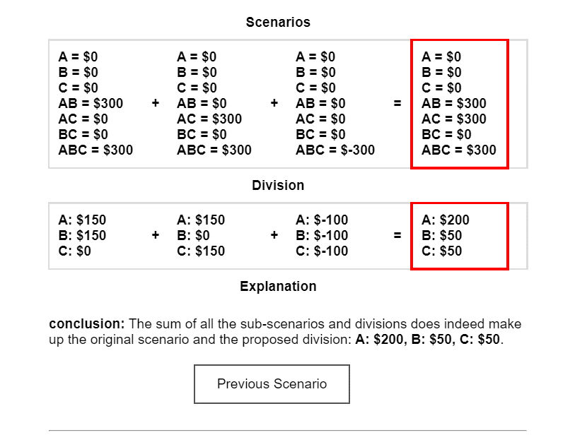
Simulation - Glove Game
Coalition | Payoff
A | 0
B | 0
C | 0
A+B | 12
A+C | 12
B+C | 0
A+B+C | 12

Slide 8
Simulation - Glove Game
ETX sub-games
Glove Game
A=$0
B=$0
C=$0
A+B=$12
A+C=$12
B+C=$0
A+B+C=$12
(1)
A=$0
B=$0
C=$0
A+B=$12
A+C=$0
B+C=$0
A+B+C=$12
(2)
A=$0
B=$0
C=$0
A+B=$0
A+C=$12
B+C=$0
A+B+C=$12
(3)
A=$0
B=$0
C=$0
A+B=$0
A+C=$0
B+C=$0
A+B+C=$-12
Allocations
A: $8
B: $2
C: $2
A: $6
B: $6
C: $0
A: $6
B: $0
C: $6
A: $-4
B: $-4
C: $-4
Notes:
For example, the glove game can be decomposed into three ETX sub-games. As you can see, the sum of all the sub-games is equal to the glove game and the sum of all their intuitive allocations is indeed equal to the Shapley value.

Slide 9
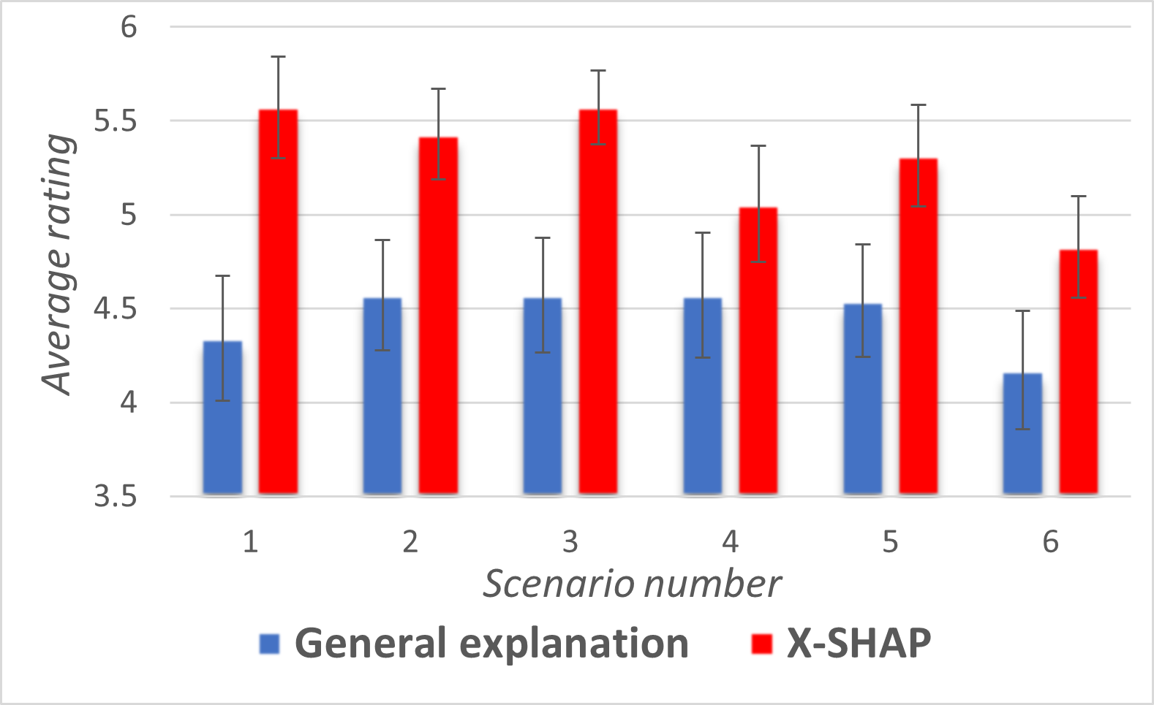
Results
Average rating of fairness:
X-SHAP: 5.3
Fixed Explanation: 4.4
Notes:
הראנו גם מובהקות במספר מבחנים סטטיסטיים.

Slide 10
THANKS!
You can find me at:
meir.nizri@msmail.ariel.ac.il
Notes:
And that's it. Thanks for listening and hope you enjoyed!

